Slide 1
Healthcare Analytics- Adv. ML PROJECT
By Divit Saini and Siddhi Jadhav

Slide 2
INTRODUCTION
Problem: Recent Covid-19 Pandemic has raised alarms over one of the most overlooked area to focus: Healthcare Management. While healthcare management has various use cases for using data science, patient length of stay (LOS) is one critical parameter to observe and predict if one wants to improve the efficiency of the healthcare management in a hospital.
This parameter helps hospitals to identify patients of high LOS risk (patients who will stay longer) at the time of admission. Once identified, patients with high LOS risk can have their treatment plan optimized to miminise LOS and lower the chance of staff/visitor infection. Also, prior knowledge of LOS can aid in logistics such as room and bed allocation planning.

Slide 3
OBJECTIVE
To accurately predict the Length of Stay for each patient on case by case basis so that the Hospitals can use this information for optimal resource allocation and better functioning. The length of stay is divided into 11 different classes ranging from 0-10 days to more than 100 days.

Slide 4
DATA DESCRIPTION
Independent Variables:
case_id: Case_ID registered in Hospital
Hospital_code: Unique code for the Hospital
Hospital_type_code: Unique code for the type of Hospital
City_Code_Hospital: City Code of the Hospital
Hospital_region_code: Region Code of the Hospital
Available Extra Rooms in Hospital: Number of Extra rooms available in the Hospital
Department: Department overlooking the case
Ward_Type: Code for the Ward type

Slide 5
9. Ward_Facility_Code: Code for the Ward Facility
10. Bed Grade: Condition of Bed in the Ward
11. patientid: Unique Patient Id
12. City_Code_Patient: City Code for the patient
13. Type of Admission: Admission Type registered by the Hospital
14. Severity of Illness: Severity of the illness recorded at the time of admission.
15. Visitors with Patient: Number of Visitors with the patient
16. Age: Age of the patient
17. Admission_Deposit: Deposit at the Admission Time
Dependent variable:
Stay: Stay Days by the patient (11 Classes ranging from 0-10, 11-20... 91-100, >100)

Slide 6
METHODOLOGY
The Steps that we are going to follow to complete this implementation is as follows:
Importing the necessary libraries
Data Loading
Reading the train and test csv files.

Slide 7
EXPLORATORY DATA ANALYSIS
Variable Transformation
In variable transformation, few columns having integer datatype are converted to object data type as those variables are categorical in nature
(hospital_code, city_code_hospital , bed_grade, city_code_patient)
.

Slide 8
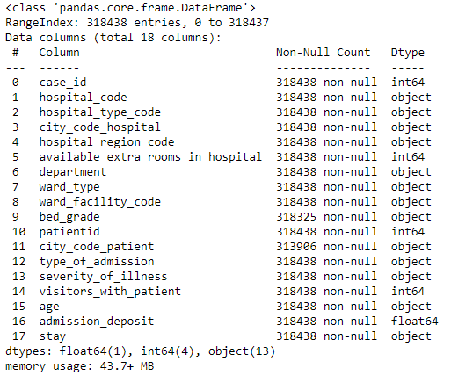

Slide 9
Handling Missing Value
There are missing values only for two categorical features(bed_grade and
city_code_patient), those missing values are imputed with the highest number of observation i.e mode
Outlier detection
For Numerical Variables: We will plot the histogram and boxplots to detect variables
Exploring /insights from the data
Exploring different categorical variables and creating new features: 'hospital_region_&_city_code_hospital’, 'hospital_type_&_hospital_code’ – this is done by grouping them with respect to the variable which is in the higher hierarchical model

Slide 10
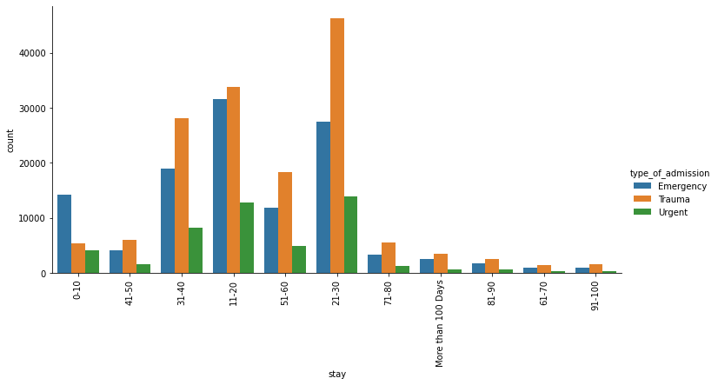
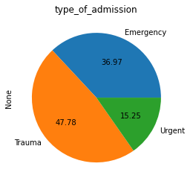
type_of_admission
Inference: It can be inferred from above count plot that there are more type of Admission is 'Trauma' and less type of Admission is 'Urgent'
From the above plot we conclude the stay of patients is highest due to the type of admission for the state of trauma for a duration of 21-30 days.

Slide 11
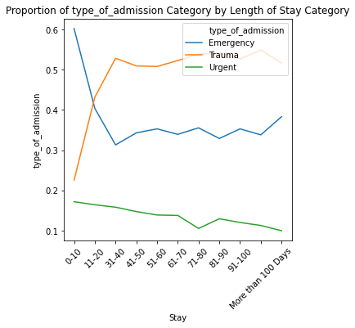
We see that the proportion of urgent admissions decreasing over the LOS.

Slide 12
FEATURE ENGINEERING
Updating data as per EDA –
Dropping columns – (Check the code)
Editing the Ward_type variable
Label Encoding
Standardization
Labelling the target variable
Splitting into Test and Train

Slide 13
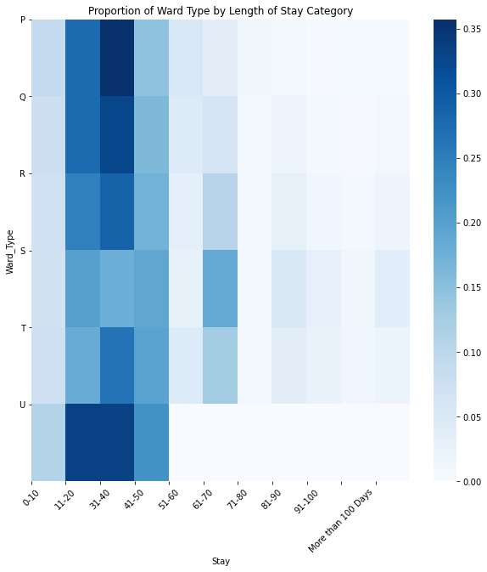
Ward_type
By looking at the above two Graph, we can conclude that
Wards has short LOS while P,Q,R,S has longer LOS.
The stay of patients is highest in all the 5 wards for a duration of 21-30 days.
Hence, we can concatenate ward types into the following super categories:
PQRU
ST

Slide 14
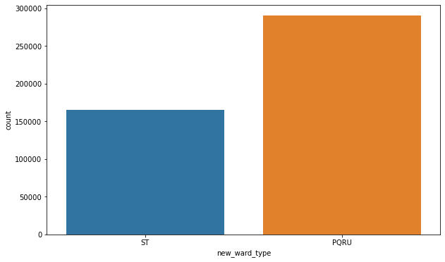
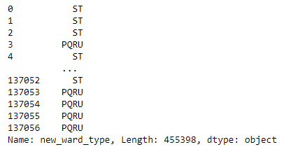

Slide 15
Label Encoding
Since most of our data is nominal and we have a lot of categorical variables, we choose label encoding vs One hot encoding.
Standardization of numerical Variables
We need to standardise the numerical variables as they have varied ranges.
Labelling the Target array
As the target variable is categorized into 11 different categories, we will label these variables.
'0-10': 0,
'11-20': 1,
'21-30': 2
'31-40': 3,
And so on….

Slide 16
MODELING
We use Random forest model for feature selection and compare the following models creeted by using those features:
Random forest classifier
Logistic Regression
Boosting: XGboost Classifier
KNN
Perfomance metrics: Accuracy and Confusion Matrix
Random Forest Classifier - Feature selection and Hyperparameter tuning
STEPS:
Creating a Baseline Model
Hyperparameter tuning: Optimize the accuracy by carrying out hyperparameter tuning of baseline random forest
Feature Selection: by Plotting the feature importance graph of the optimized model
Hyperparameter Tuning of features selected:
Optimize the accuracy based on these features using hyperparameter tuning

Slide 17
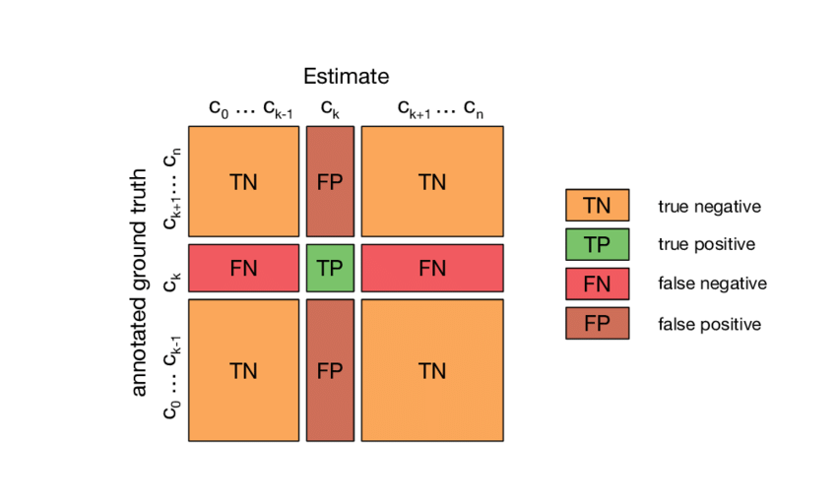
Logistics Regression
Building a logistics regression model on the features selected gave an training accuracy of 36.02% and a validation accuracy of 36.09%.

Slide 18
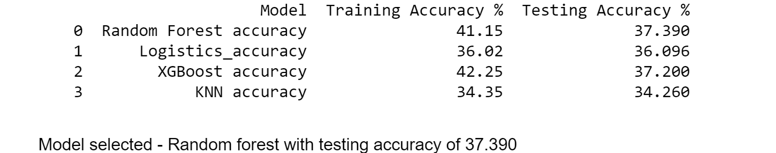
RESULT AND MODEL SELECTION

Slide 19
CONCLUSION
The best model selected after feature selection, hyperparameter tuning and comparing the accuracy between different models is
**Random Forest Classifier (max_depth = 13, number of Trees bagged = 600, minimum sample split = 25) with training and testing accuracy of 0.411 and 0.3739.**
Hence, this model was saved and loaded to predict Length of stay based on 6 features
1. "visitors_with_patient",
2. "admission_deposit",
3. "city_code_patient",
4. "available_extra_rooms_in_hospital",
5. "age",
6. "bed_grade"

Slide 20
Improvements
Suggested methods can improve the accuracy of the model:
1. Feature selection through RFE, PCA
2. Hyperparameter tuning of xgboost model
3. Undersampling and oversampling of the data as the classes in the target variable is not biased to lower Length of Stay

